Slide 1
3M™ Universal Cover Tape (UCT) 2688A application procedure
Electronics Materials Solutions Division
January 2019 (updated)

Slide 2
Peeling design and mechanism of UCT
Unique peeling design
Only the middle portion of the tape will be peeled off along the score lines at sides
Create a very uniform peeling with narrow peel range
Adhesive
Track
Score
Tracks
Score lines
Adhesive at sides
Adhesive edges remain adhere to the carrier tape, only the middle part will be removed
Adhesive free at middle portion, helps reduce risk of adhesive contact or contamination to die surface

Slide 3
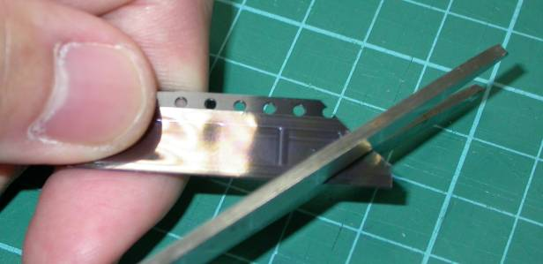
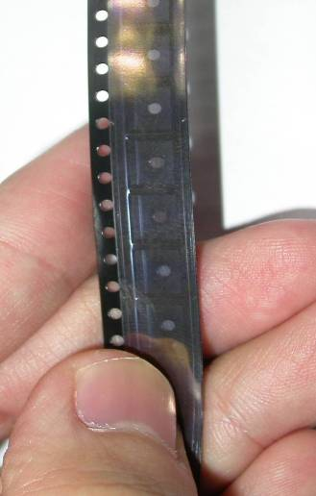
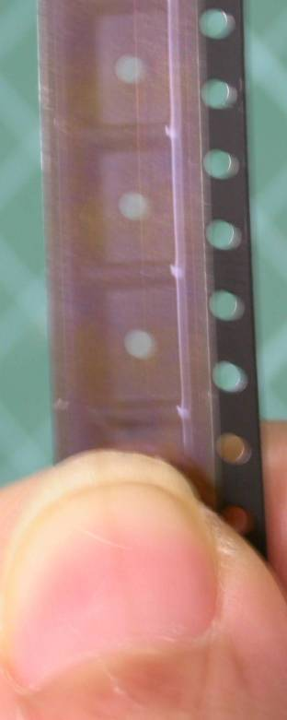
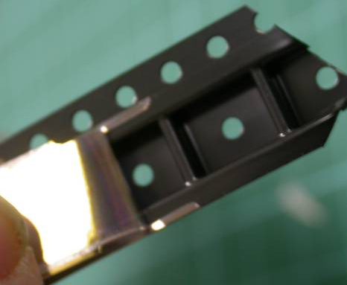
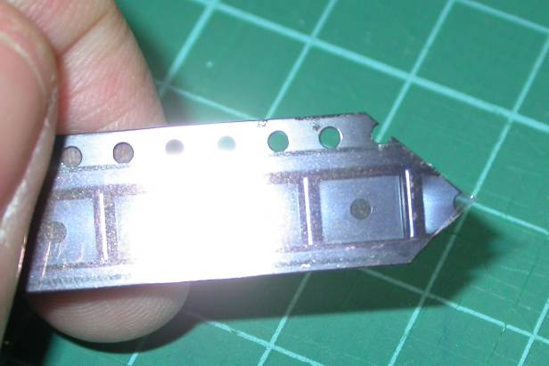
Recommended UCT initiation and peel direction
✓
x
3. Peel off the UCT at 180º angle until the tracks are fully initiated and cut into the center part.
1. Hold the carrier tape with sprocket holes on the left hand side.
2. To assist initiation, cut a V-shape on the carrier tape.

Slide 4
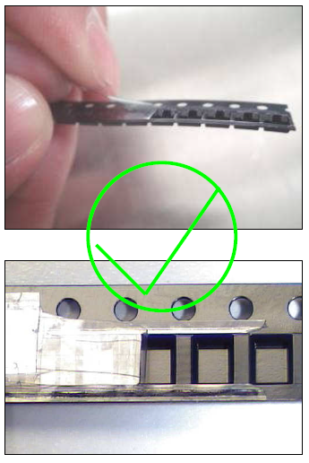
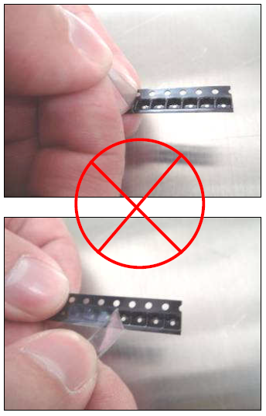
Recommended UCT peel angle
Keep UCT peel off angle close to 180º, ensure the middle portion start up prior to setup on feeders.
Correct peeling method
Incorrect peeling method

Slide 5
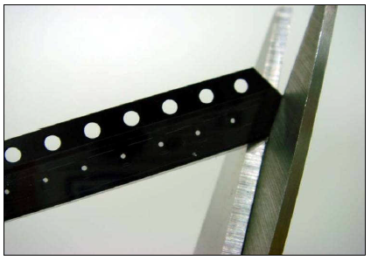
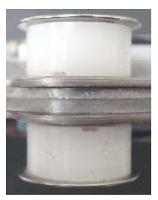
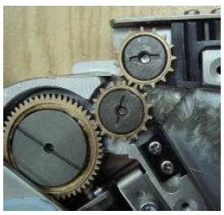
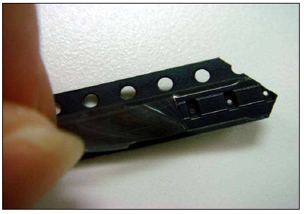
Recommended process for UCT taped reel feeder loading
1. Clean every possible position that might have adhesive remaining on the feeder, rollers and gears, etc. Empty the cover tape recycle bin. Clean the feeder tracks.
2. Use a scissor to cut the leader of UCT taped reel into a ‘V’ shape
3. Peel off the UCT. The middle portion initiates through the tracks and along the score line

Slide 6
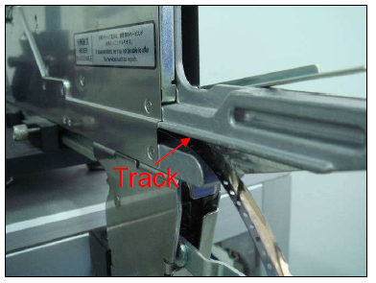
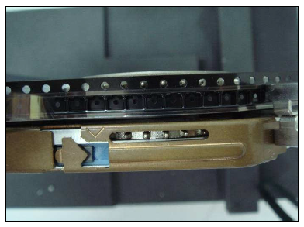
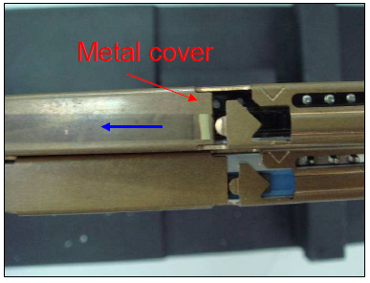
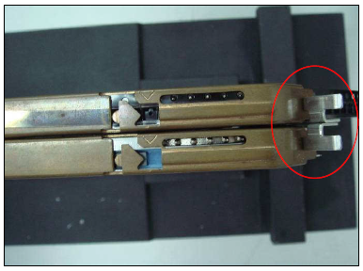
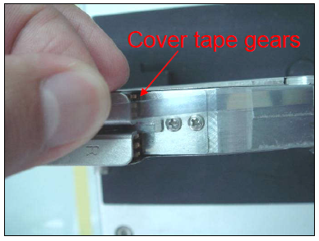
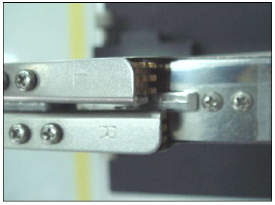
Recommended process for UCT taped reel feeder loading (continued)
4. Insert the tape into the feeder track.
5. Set the carrier tape to the feeder sprocket gear (index gear).
6. Pull back the cover tape through the feeder metal cover.
7. Lock the metal cover
8. Index the feeder, leave enough cover tape length to the cover tape gears
9. Insert cover tape into the cover tape gears. Ensure the cover tape locked by the gears & no defects during indexing

Slide 7
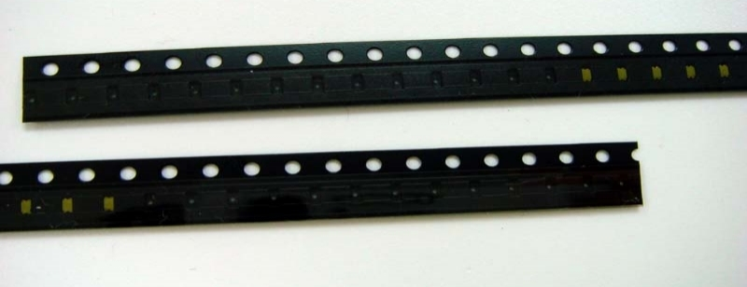
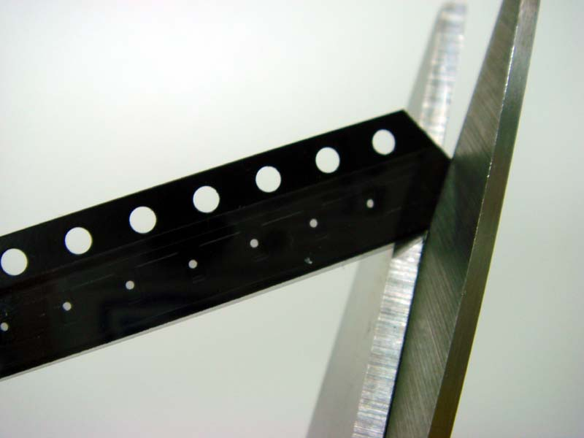
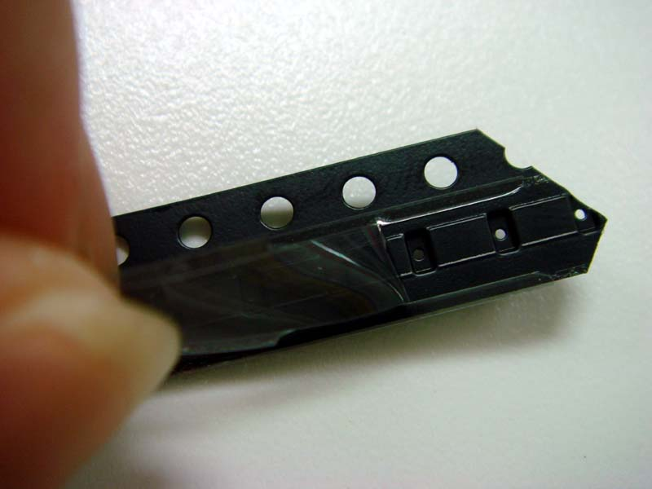
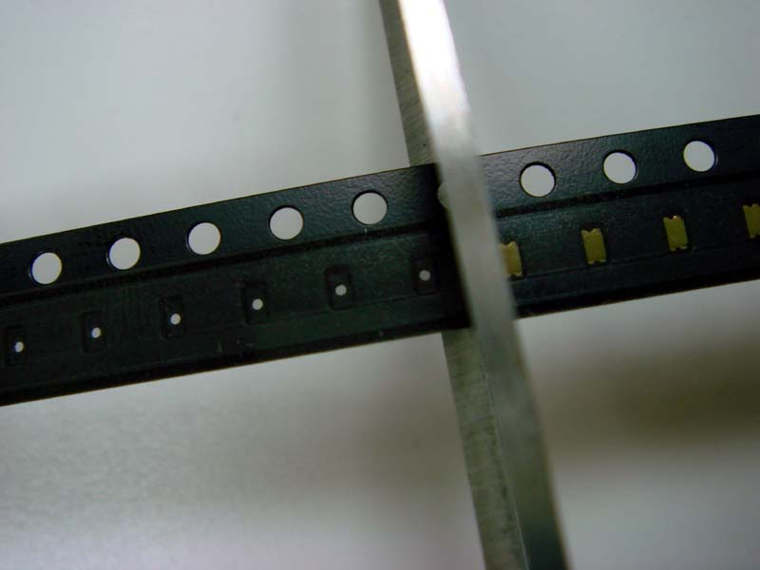
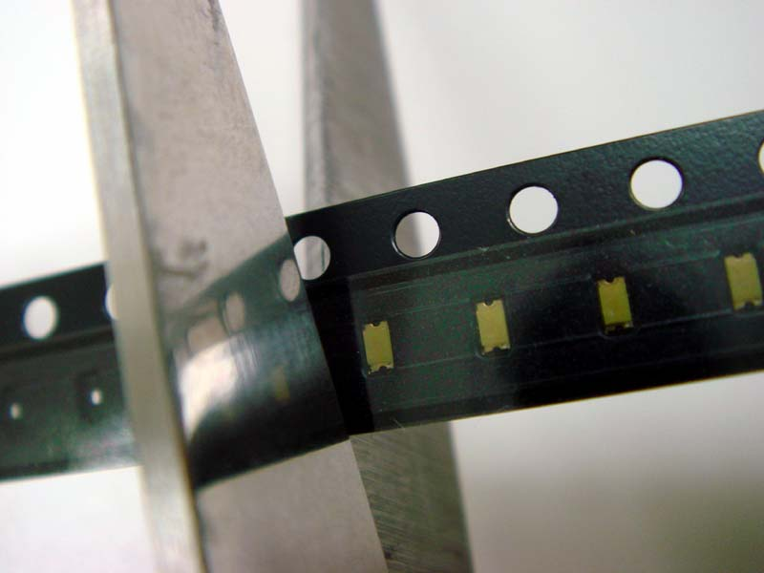
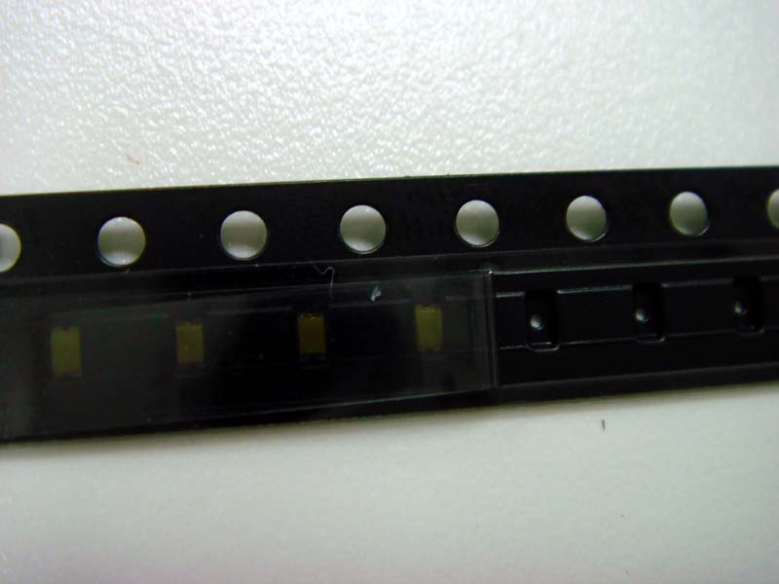
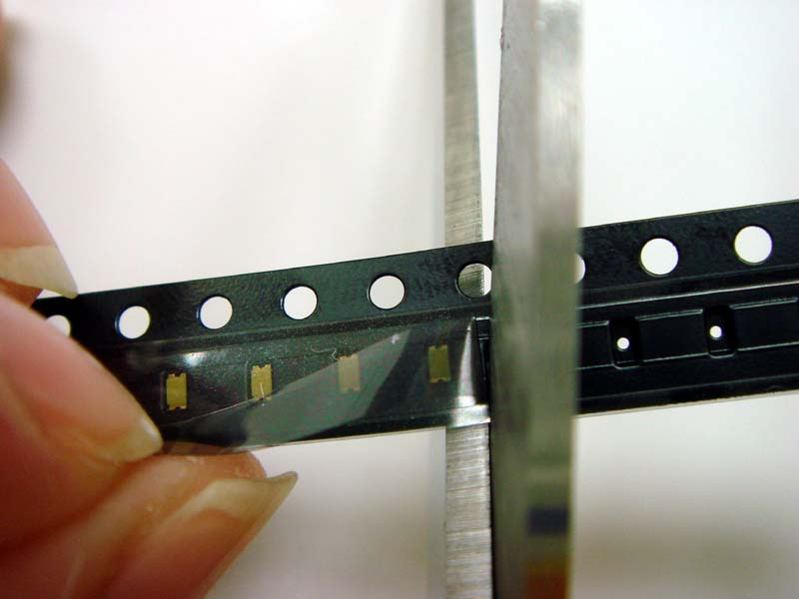
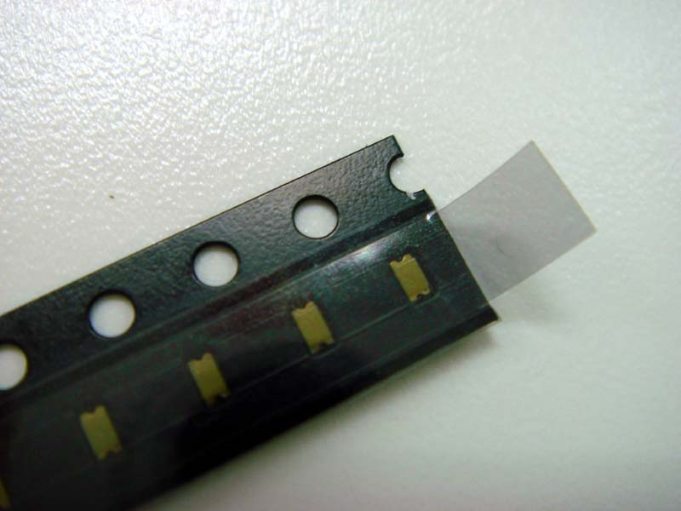
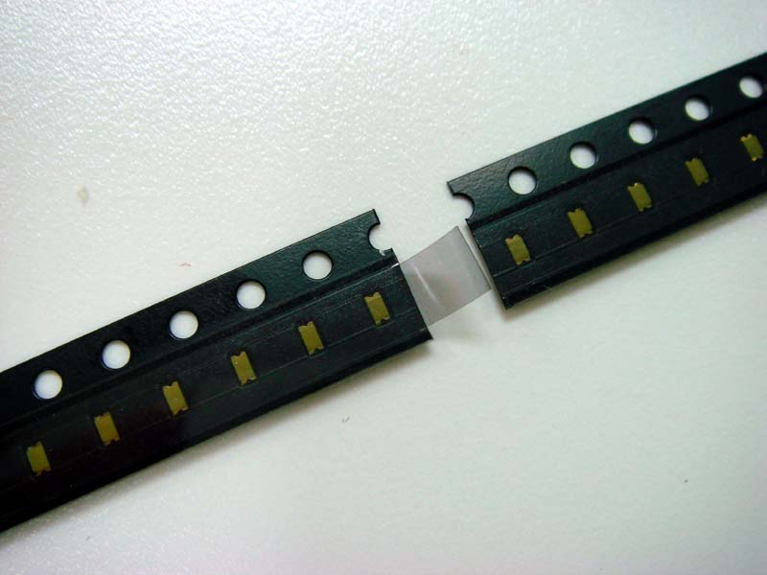
Recommended procedure: New reel start up for reel to reel splicing at SMT machine
Trailer of the used reel
UCT “Tipped-Off”
tail (~ 4mm)
Splicing tape
UCT
UCT
Leader of the new reel
Trailer of the used reel
Leader of the new reel
1. Start –up procedure for leader of the new reel
2. Start –up procedure for trailer of the used reel
Use a scissor to cut the leader of UCT taped carrier into a “V” shaped as shown in the photographs above in Fig 1a & 1b
1a
1b
2a
2b
Use a scissor to cut off the empty pocket in the trailer of the used reel to the nearest filled pocket as shown in Fig 2a & 2b
4mm
1c
1d
1e
The carrier tape is now ready for splicing
Peel off the UCT to the first component exposed on the leader of the new reel.
Cut away the excess carrier tape and leave a UCT “Tipped-Off” (approximately 4mm) as shown in Fig 1e
Trailer of used reel
Leader of new reel

Slide 8
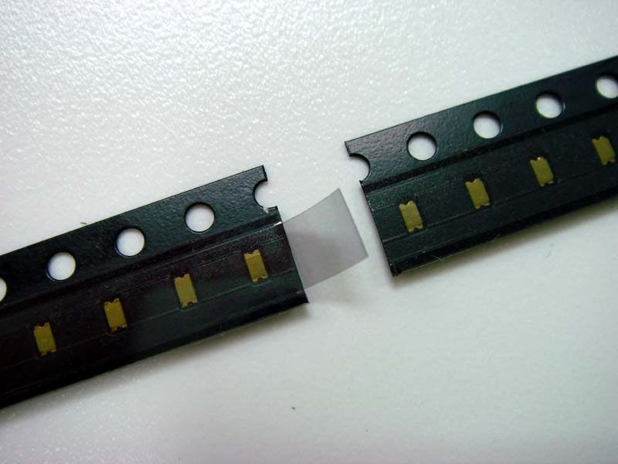
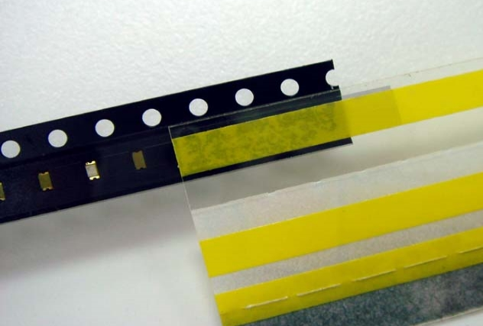
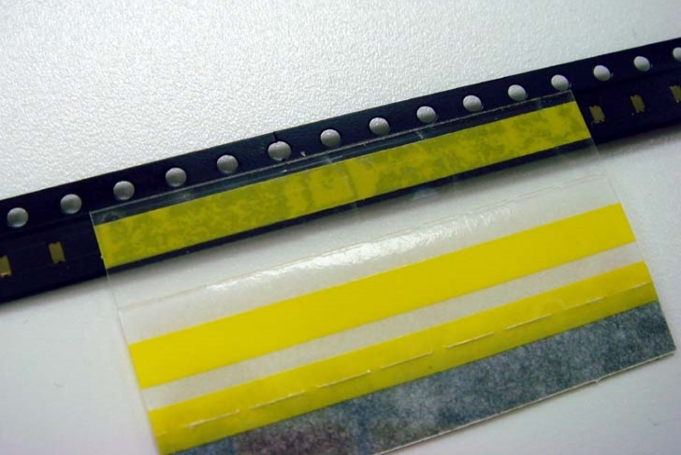
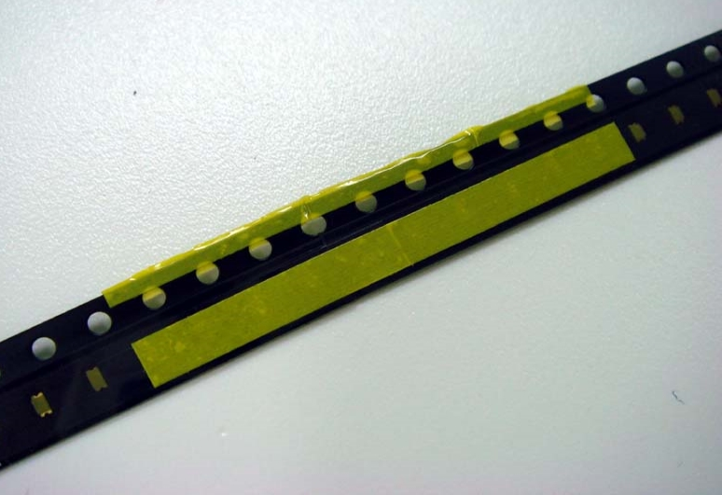
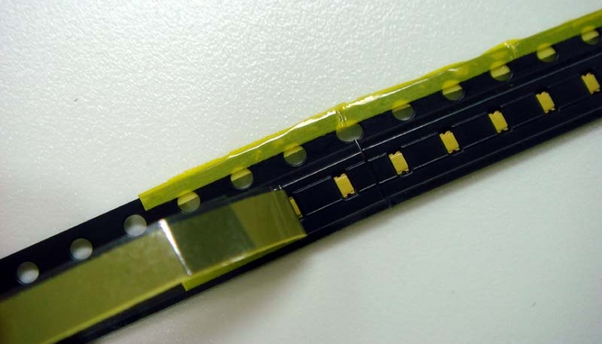
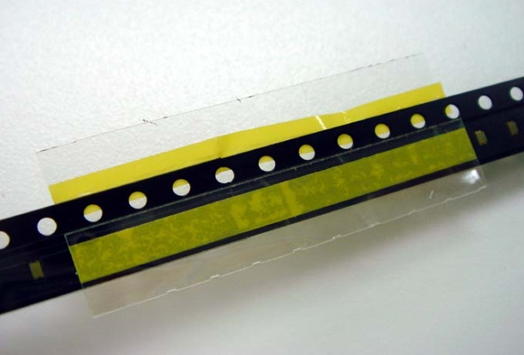
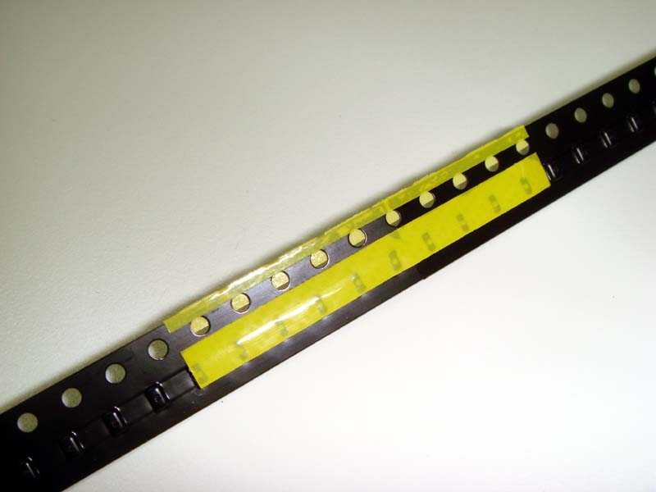
Recommended procedure: Reel to reel splicing at SMT machine
Cover tape removal
direction
UCT “Tipped-Off” tail
Splicing tape
Leader of the new reel
Trailer of the used reel
UCT
UCT
Leader of the new reel
Trailer of the used reel
“Tipped-Off” (~approx. 4mm)
Joint the leader of the new reel to the trailer of the used reel using a splicing tape as shown in the photographs
Feeders used on SMT machines
Wrap the splicing tape over the UCT taped carrier. The splicing tape will hold the 2 strips of taped carrier firmly through the top, back and sprocket support.
Peel the UCT from the taped carrier, the splicing tape is able to hold on firmly without delamination.

Slide 9
3M contacts for information
For any questions:
Please feel free to contact 3M local team in your area
Or visit 3M website: www.3M.com/electronics (Product for business → Electronics → Semiconductor → Tape and Reel) for more 3M carrier and cover tape product information

Slide 10
IMPORTANCE NOTICE
Safety Data Sheet: Consult Safety Data Sheet before use.
Regulatory: For regulatory information about this product, contact your 3M representative.
Technical Information: The technical information, recommendations and other statements contained in this document are based upon tests or experience that 3M believes are reliable, but the accuracy or completeness of such information is not guaranteed.
Product Use: Many factors beyond 3M’s control and uniquely within user’s knowledge and control can affect the use and performance of a 3M product in a particular application Given the variety of factors that can affect the use and performance of a 3M product, user is solely responsible for evaluating the 3M product and determining whether it is fit for a particular purpose and suitable for user’s method of application.
Warranty, Limited Remedy, and Disclaimer: Unless an additional warranty is specifically stated on the applicable 3M product packaging or product literature, 3M warrants that this product will be free from defects in material and manufacture for a period of one year from the time of manufacture. 3M MAKES NO OTHER WARRANTIES OR CONDITIONS, EXPRESS OR IMPLIED, INCLUDING, BUT NOT LIMITED TO, ANY IMPLIED WARRANTY OR CONDITION OF MERCHANTABILITY OR FITNESS FOR A PARTICULAR PURPOSE OR ANY IMPLIED WARRANTY OR CONDITION ARISING OUT OF A COURSE OF DEALING, CUSTOM OR USAGE OF TRADE. If the 3M Product does not conform to this warranty, then the sole and exclusive remedy is, at 3M’s option, replacement of the 3M product or refund of the purchase price.
Limitation of Liability: Except where prohibited by law, 3M will not be liable for any loss or damage arising from the 3M product, whether direct, indirect, special, incidental or consequential, regardless of the legal theory asserted, including warranty, contract, negligence or strict liability.
Electronics Materials Solutions Division
3M Center, Building 224-3N-11
St. Paul, MN 55144-1000
1-800-251-8634 phone
651-778-4244 fax
www.3M.com/electronics
3M is a trademark of 3M Company.
©3M 2019. All rights reserved.

Slide 11
Thank you

